Slide 1
NSB Renovation Concerns

Slide 2
Overview
Faculty
Students
NSB Renovation: 10 years in the making…
Current Working State of The NSB
Appeal/Fund Raising/Endowments
Growth in the Sciences
Pedagogical Goals
Extramural Funding

Slide 3
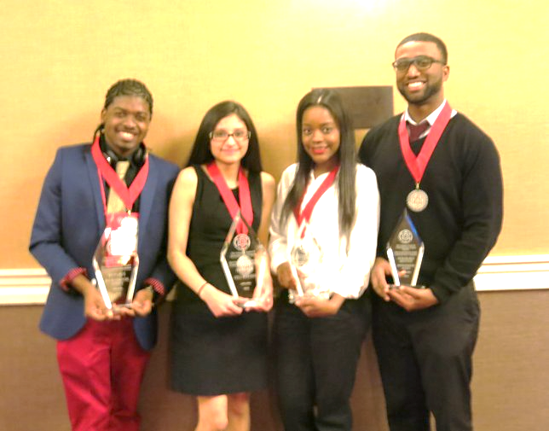
Drivers of Revenue, Growth, & Student Outcomes

Slide 4






Drivers of OW Budget
Reserves, HEERF III 14.1%
STUDENT TUITION
STATE SUPPORT
Fees & Rentals
15.2%
RESIDENCE HALLS
REVENUE
Student Tuition
44.6%
Sources
FEES & RENTALS
Residence Halls
7.6%
RESERVES
State Support
18.5%
Source: Martha Santana

Slide 5
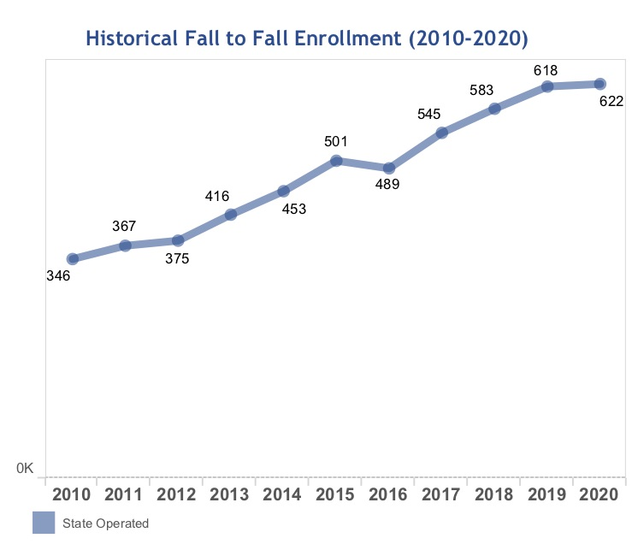
Physical, Life Science, and Technology: 13% of Total Enrollment
Near two-fold
Increase in Student
Enrollment over 10 years
+180%
https://www.suny.edu/about/fast-facts/

Slide 6
Physical and Life Sciences Growth
Fall 2021 majors served by NSB:
Biology, Biochemistry, Bioinformatics and Computational Science, Chemistry, and Public Health
Department | # of students | Tenured or tenure-track | Non-tenure track | Adjunct
Biological Sciences | 623 | 10 | 2 | 10
Chemistry & Biochemistry | 97 | 8 | 2 | 6
Public Health | 234 | 5 | 1 | 2
Source: Courtney Raeford
Notes:
Spring 2021: 1310 enrolled students in all courses bio, 983 in chem, 405 public health
Biochem: 64
Chem:33

Slide 7
Physical and Life Sciences Growth: URM
https://www.suny.edu/about/fast-facts/

Slide 8
On Campus Programs That Have Historically Supported URMs & Financially Disadvantaged
Students
CSTEP + LSAMP
Standardized tests preparation
Academic and career development activities
Graduate/professional school admissions preparation
Book Vouchers
Travel support to Statewide and National Conferences
Stipends for mentored research
Faculty active engagement in promoting student applied learning and extracurricular research activities.
Notes:
1994 – Now

Slide 9
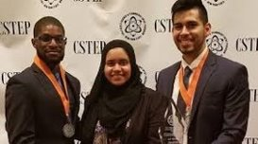
% URM Graduation
SUNY Wide
OW
*45% URM graduates in Biological Sciences major last 5 years
Source: Courtney Raeford
https://www.suny.edu/about/fast-facts/

Slide 10

Faculty (and Student) Goals
CUREs
Applied learning

Slide 11
Trends in Extramural Funding
Years | Direct | Indirect
2016 - 2020 | $5,720,147 | $432,119
Source: Thomas Murphy

Slide 12
Grant Critique Weaknesses: Examples
Training Grant Critiques (RISE) 2018
“Most of the research faculty at SUNY OW have limited funding – mainly internal funds.”
“There is concern that the present research environment at SUNY OW is weak and may struggle to provide meaningful research experiences.”
“There are letters of support from SUNY-OW, but they are underwhelming.”
“Given the low graduation rates and the low number of students that currently go to PhD programs, there does not appear to be a culture of research at SUNY-OW.”
Independent Grant Critiques (R15) 2018
“The PI has not demonstrated a track record exposing students to more sophisticated environments such as proposed in this application. It is unclear if this could be accomplished in the current application.”
“The animal studies (Aim 3) will be carried out at Drexel University College of Medicine. It is unclear how this part of project would benefit undergraduate students at SUNY Old Westbury.”

Slide 13
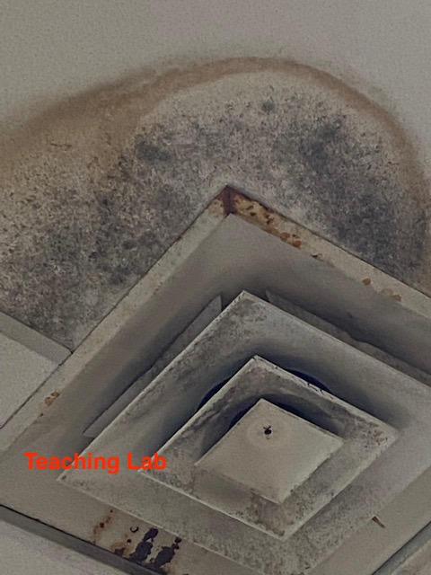
Current Working Conditions of the NSB

Slide 14
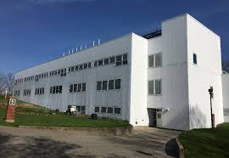
Current Working Conditions of The NSB: Growing Pains & Space Limitation Concerns
NSB 40 years old
Space not sufficient for:
Biology, chemistry, biochemistry, bioinformatics and computational science, and public health majors
Research: biology, chemistry, and biopsychology research
Exceeded estimated growth by 3 years (i.e., current growth rate was projected to happen in 2024)

Slide 15
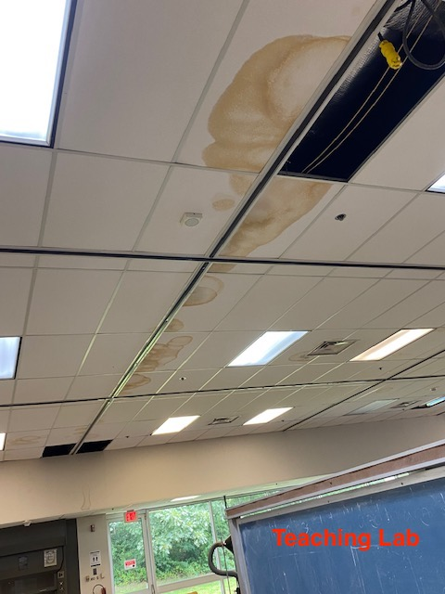
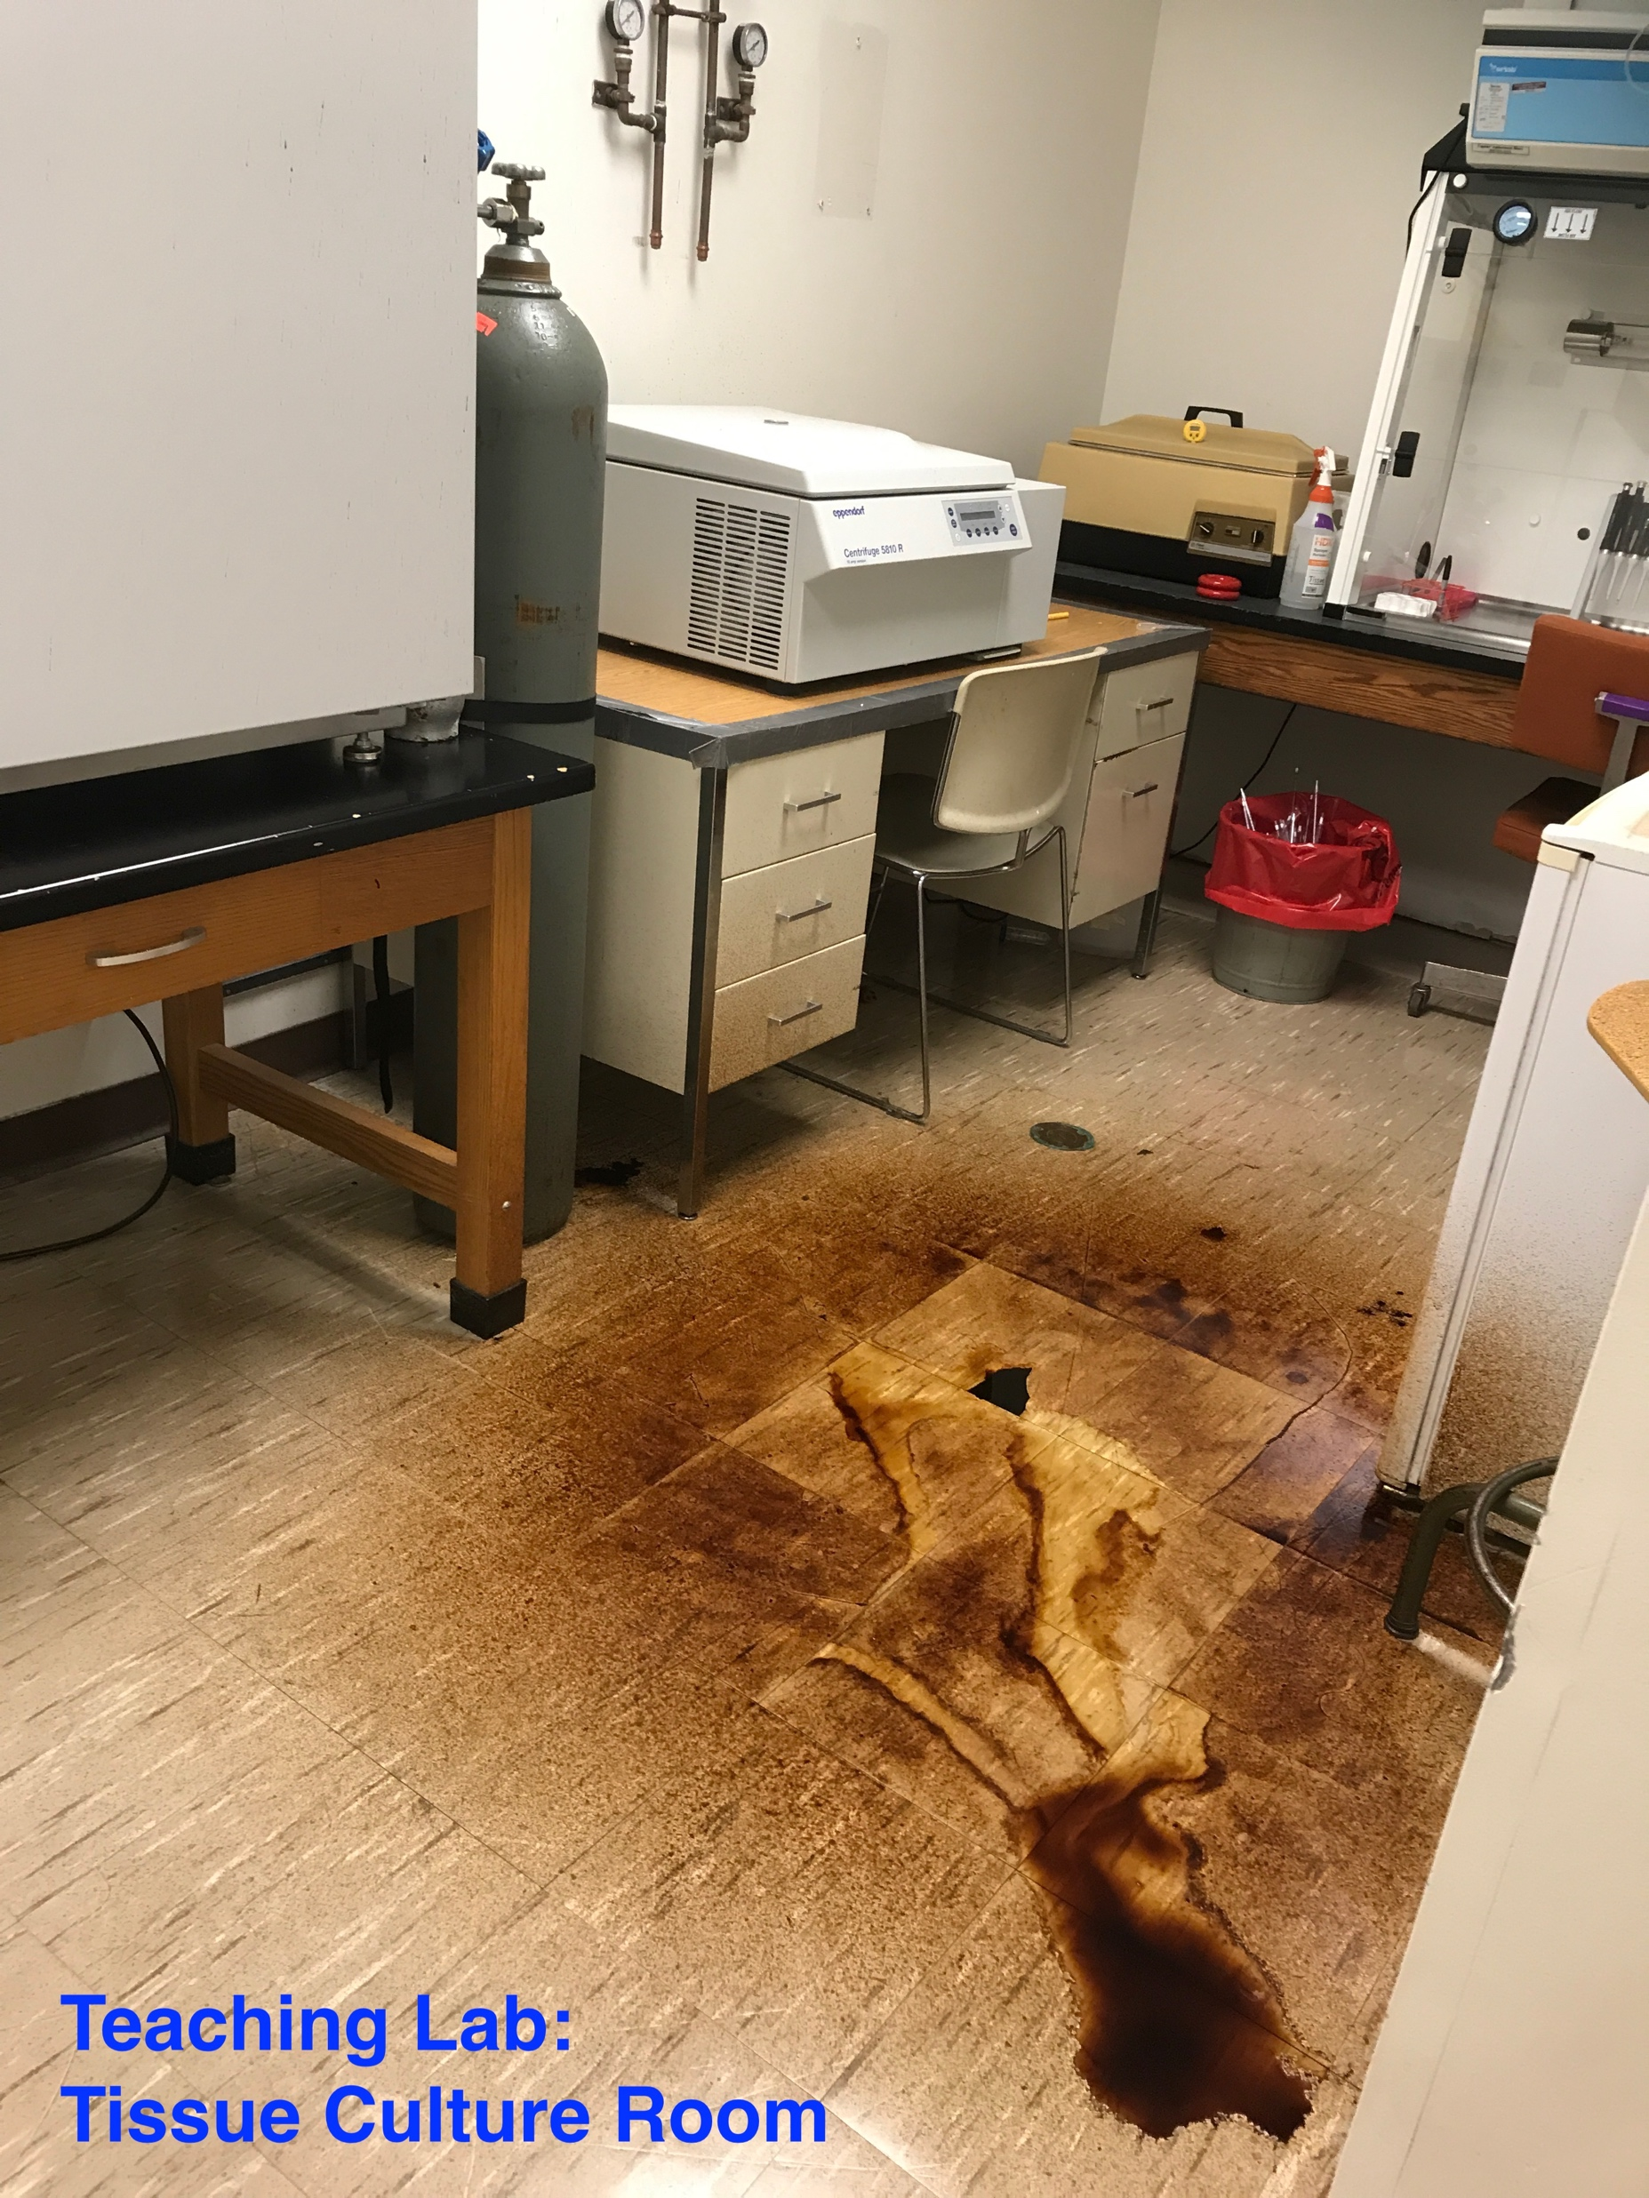
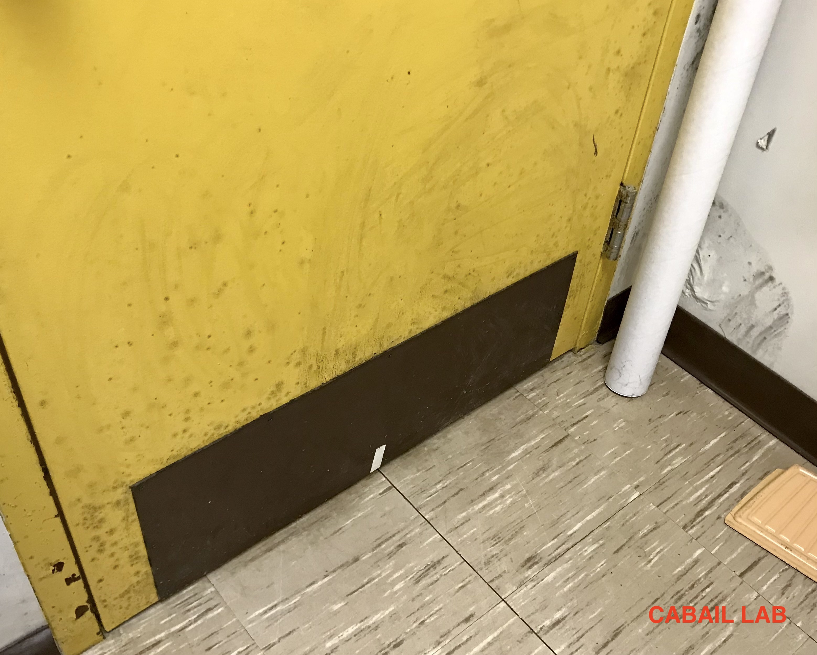
Current State of NSB: Concerns
Poor ventilation
Poor temperature regulation
Inadequate Laboratory Space
Interruption to teaching
Mold
NMR temporary HVAC
Temp AC in vivarium in violation of IACUC regulations
Not enough equipment
Note: minor issues not fixed due to ‘building will be renovated soon’

Slide 16
Current State of NSB Unsustainable
Campus | Fall 2020 Enrollment | Student : Space | % URM STEM
OW* | ↑ 622 | 102 gsf per student (88 gsf in Fall 2021) | 59%
Buffalo State | ↓ 516 | 434 ft² per student | 57%
Farmingdale^ | ↓ 404 | 297 ft² per student | 42%
New Paltz | ↓ 339 | 227 ft² per student | 29%
Oneonta^ | ↓ 628 | 121 ft² per student | 27%
Fredonia | ↓ 309 | 608 ft² per student | 20%
*Post-renovation would be the same ratio without an addition
^Have separate Biology, Chemistry and other science buildings and/or Core Facilities
Calculated based on undergraduate Physical, Life Science and Technology enrollment + science building size: https://www.suny.edu/about/fast-facts/
Notes:
https://sites.newpaltz.edu/news/2017/03/suny-new-paltz-celebrates-opening-of-science-hall/
https://www.csarchpc.com/projects/suny-Oneonta
https://sites.newpaltz.edu/news/2017/03/suny-new-paltz-celebrates-opening-of-science-hall/
https://www.cannondesign.com/our-work/work/suny-buffalo-state-science-building/
https://www.fredonia.edu/about/science-center-complex

Slide 17
Renovation Concerns

Slide 18
Timeline of NSB Renovation
NSB renovation on capital planning radar
Discussion ends.
Architectural design begins (renovation ONLY)
Renovation start ETA
2010 - 2013
2015
2017
2019
2021
2014
2016
2018
2020
2022
Space survey and projected growth
Published survey and recs:
Reno + addition
Bring in CIS and IT
Concept planning:
New building
Renovation + addition
CHANGE IN PLANS

Slide 19
Concerns: Original Renovation Options
Building | GSF | Cost
Addition Renovation TOTAL | 115,200 63,300 178,500 | $94,712,000 $34,547,000 $129,259,000
Addition Renovation TOTAL | 50,400 63,300 113,700 | $41,437,000 $34,547,000 $75,984,000
Addition Renovation TOTAL | 39,900 63,300 103,200 | $32,804,000 $34,547,000 $67,351,000
*Renovation ONLY | 63,300 | $36,627,000
*Trailers for labs and research (~17 mil)
Notes:
$17 million for trailers

Slide 20
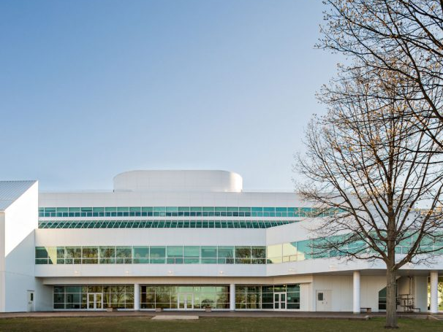
Concerns: Revised Renovation Plan
Only Phase 1 guaranteed (survey taken back in 2014).
Reduced Teaching Laboratory Space after Phase 1 only
Indeterminate start of Phase 2
Alternate location for Teaching Labs during Phase 1 uses capital budget and college funds for:
Renovate E-wing (space reserved for IT)
Trailers ~4+ years without consideration for phase 2
Designer for exterior of building.

Slide 21
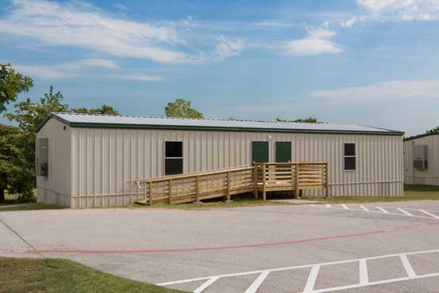
$17,000,000: Cost of Trailers for Temporary Lab
Notes:
32% of the budget will be spent on temporary space;

Slide 22
Concerns: Impact on Students
Detrimental to Science Departments and OW
Not enough Teaching Laboratory or Research Laboratory space in the proposed plan
No commitment to equip the new labs with Scientific equipment that is currently in teaching labs for 40 years.
Displacement of students into trailers for less optimal learning
Bad optics across SUNY, reduced quality of education
Discontinuity in student learning: No applied learning skills
May Reverse enrollment growth in sciences at OW-Student
Reduced student retention
Reverse enrollment growth in sciences at OW

Slide 23
Concerns: Impact on Students
Other Majors Impacted
School of Education:
Biology 7-12
Adolescence Education: Biology
Chemistry 7-12
Adolescence Education: Chemistry
Middle Childhood Education: Biology
Early Childhood Education: Biology
2. College-wide (SAS, SBS, SOE):
GE requirement: 1 course in the natural sciences

Slide 24
Concerns: Impact on Faculty
Faculty research expected to continue (i.e., hazardous conditions). Technically not feasible to carry out experiments with intermittent vibrations.
Discontinuity in junior faculty research.
Research momentum disturbed and disrupted, lose potential for extramural funding
Can negatively impact Faculty retention
Disruption of mentored student research.
Success rate of mentored students higher
Reduced opportunity for professional and pedagogical advancement.

Slide 25
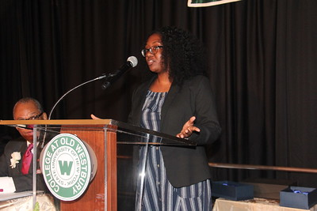
APPEAL
Prioritize renovation of NSB
Continue to increase URM representation in STEM​
Continue to drive enrollment ​
Expand revenue stream through external grants and endowments.​
Add a building extension to expand lab space
Surge space for Renovation instead of temporary spaces during renovation.​
Accommodate enrollment growth​
Accommodate CURE and applied learning across science curriculum.​
Single phase renovation for NSB
Expedited construction time: least disruptive​
Standardization of materials for the whole building.
Funding for new equipment in the new and renovated building
No trailers : Capital can be used for permanent improvement
Reassign available office space and lecture halls in NAB and CC during Renovation.

Slide 26
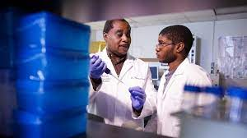
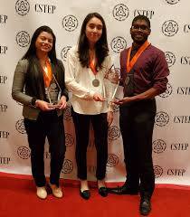
APPEAL
Support OW mission to serve URM.
Appeal to SUNY to augment support for SUNY OW.
Appeal to Governor to augment support for SUNY OW CAPITAL PROJECTS
Raise funds from OW Foundation: a serious and actionable fund-raising plan to increase the college's endowment and enlist partners for the renovation project.

Slide 27
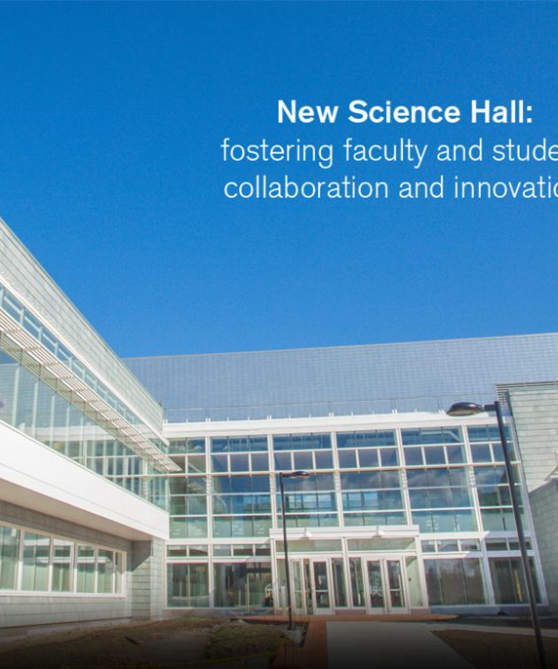
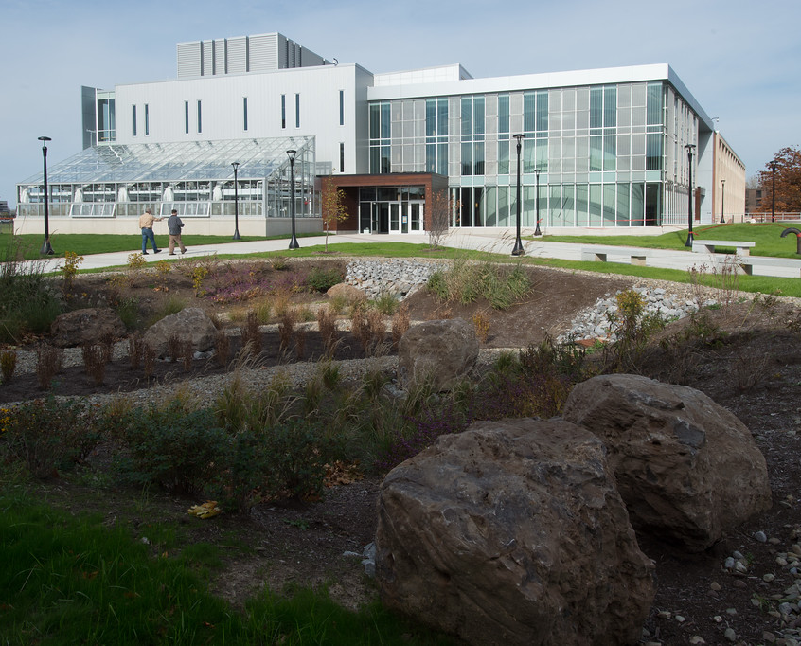
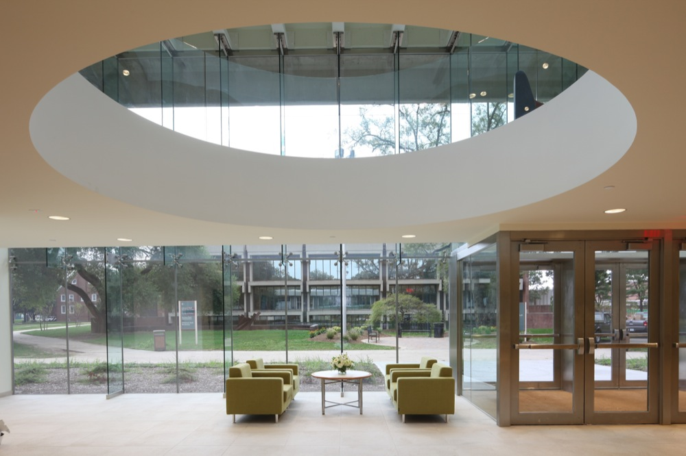
SUNY Science Building Renovations
New Paltz
Buffalo State
Farmingdale
Notes:
Top: New paltz, buffalo
Bottom: Farmingdale

Slide 28
Health Professions Enrollment Outcome
 | 2010-2015 | 2016-2021
Applied | N/A | 119
Enrolled | 21 | 62*

Slide 29

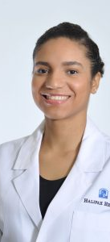
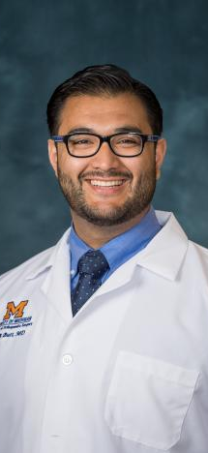
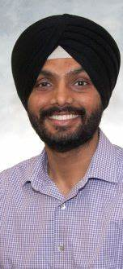

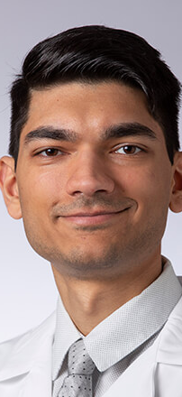
Evidence of Success in our Alumni: Scientists, Physicians, Dentists, Nurses, and other Allied Health Professionals

